Slide 1


Beer Data Analysis
Analyzing Beer data and creating a machine learning algorithm to help users make the decision which beer they should get based on flavor profiles.

Slide 2




The Team
<- Timothy Malasky
github.com/Tmalasky
<- Jack Moletteire
github.com/jmoletteire
<- Souleymane Ndiaye
github.com/muurid1

Slide 3
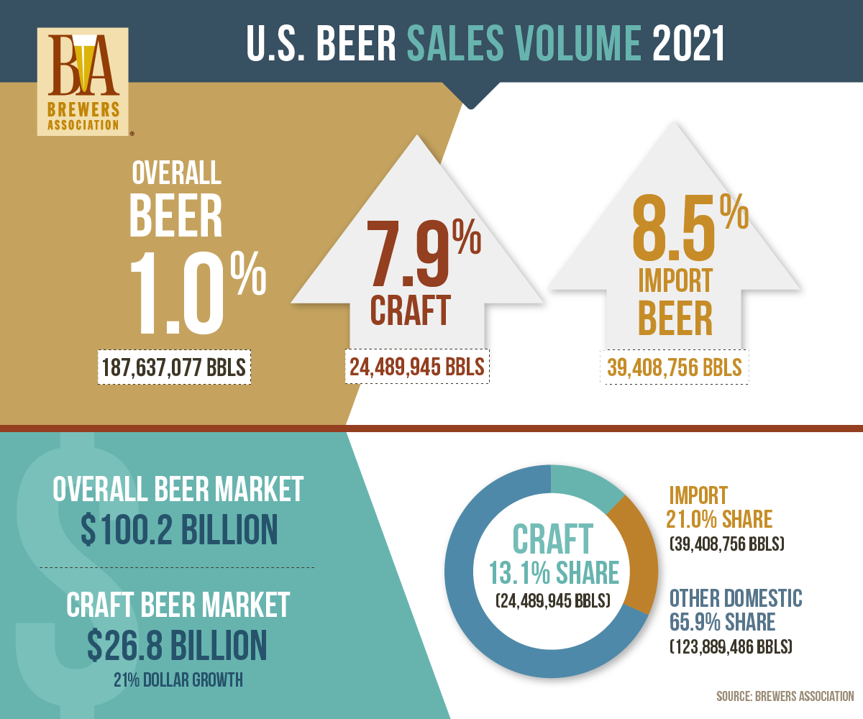
Why Beer?
Craft beer is becoming increasing demanded by consumers in today’s market.
Consumers’ willingness to spend more on craft beer based on variety, flavor and quality has increased since its beginnings in the 1960s.
Craft beer is typically made with higher quality ingredients, which provides consumers with a more flavorful and distinctive tasting beer than mass-produced options.
Those reaching for a craft beer often want something new.

Slide 4

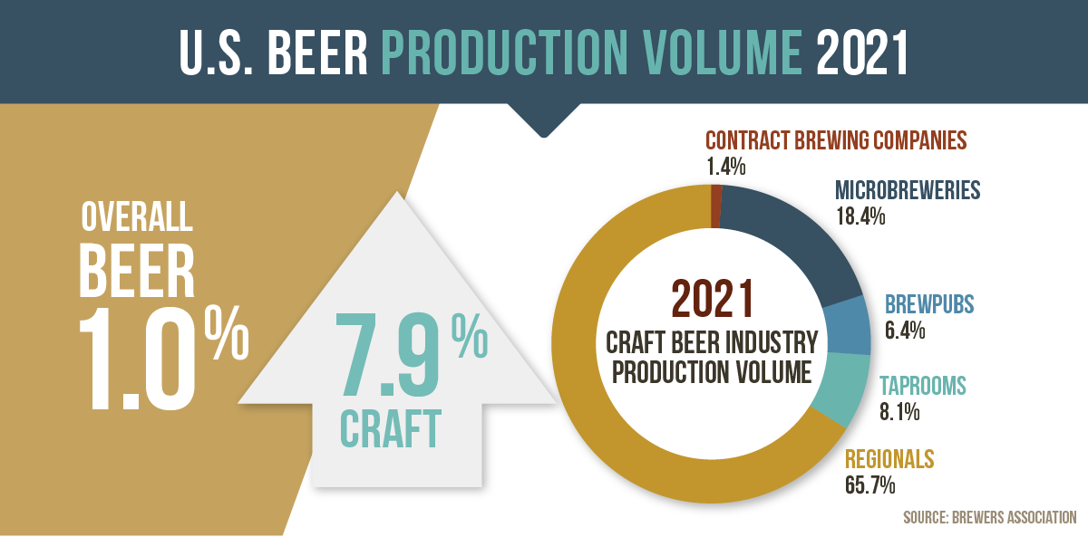
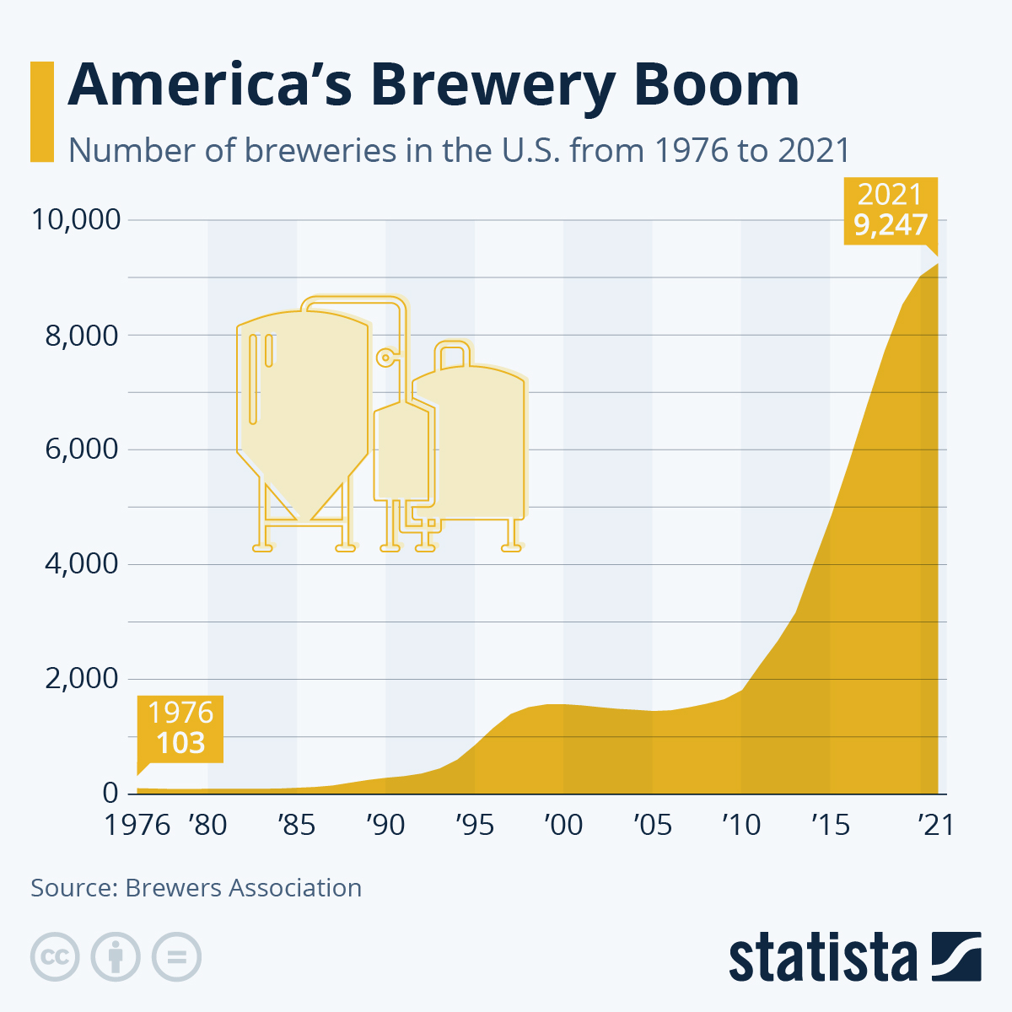
Craft Beer Trending Higher in America each year
The First graph shows U.S. Beer Production Volume in 2021 based on breweries.
The Second graph shows the numbers of breweries being open in the U.S. growing each year since 1976.

Slide 5
Database
The database we are using is from Kaggle and is a Beer Profile and Ratings Data Set.
The Database shows the name and style of beer and is broken down by different descriptions which we use in our recommender system to determine the right beer just for you!
The Database also shows different review scores based on the aroma, appearance, palate, taste, and overall scores.

Slide 6








Software and Technologies
Python
Pandas Library
Machine Learning Algorithm – Scikit-Learn
PowerPoint
Tableau Public
SQLite
CSS
HTML

Slide 7
Machine Learning
We built a multi-class classification model that analyzes user preferences to determine preferred beer style and make recommendations.
Preliminary analysis and preprocessing involved analyzing variables and grouping related data. A SQLite database was created to store several tables of related information.
The model was trained on beer taste profile (e.g., Astringency, Bitterness, Saltiness, etc.) and chemical composition (ABV, min./max. IBU) would be considered in the construction of the model, while more opinionated statistics like review scores, were excluded.

Slide 8
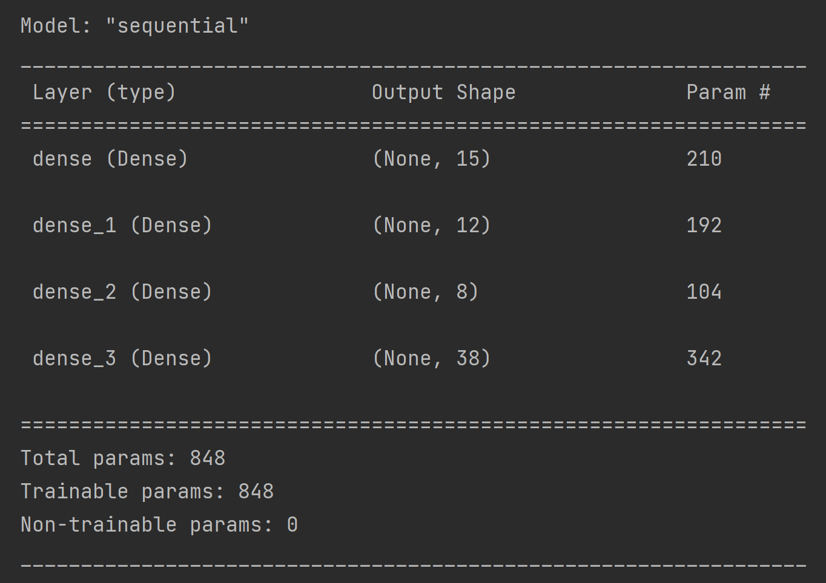
The Model

Slide 9
Questions for our Dataset
What style of beer is most popular based on data from consumers?
Which flavor profile is most popular based on the dataset?
What type of beer you might prefer based on your input of type of taste preferences?
Which breweries have the most popular beers based on reviews?

Slide 10
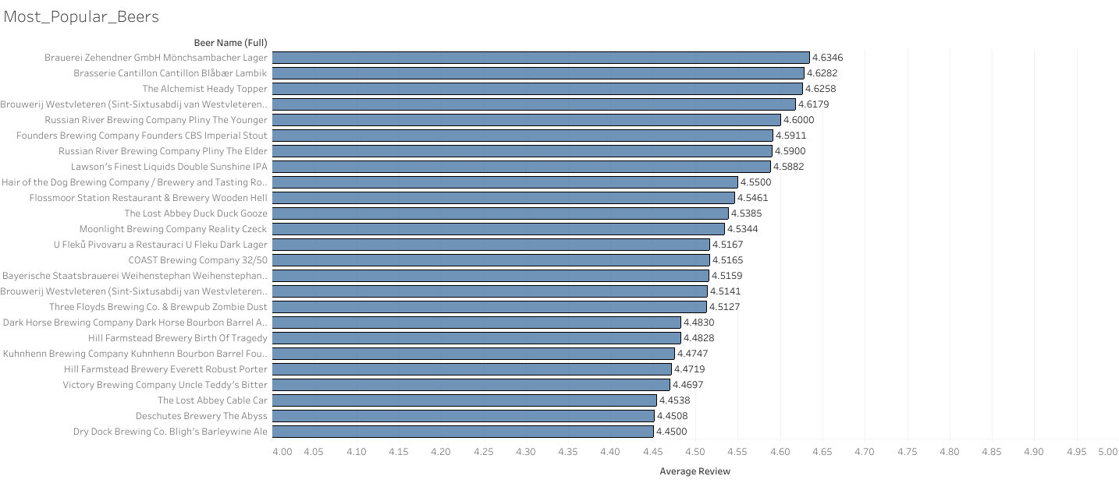
Most popular beers based on reviews from the Dataset.
Most popular beers based on overall review scores using a 4-5 scale. Showing the top 25 in this category.

Slide 11
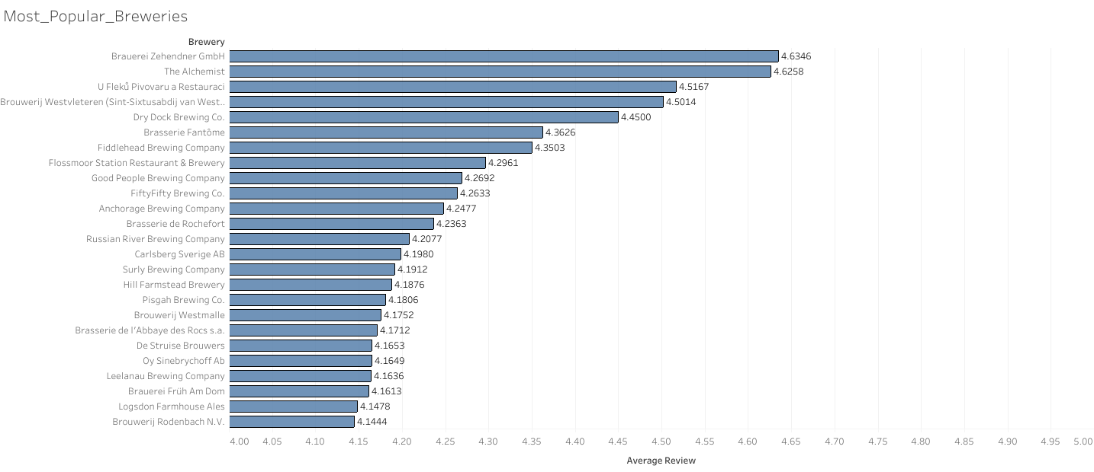
Most popular Breweries based on reviews from the dataset.
Most popular Breweries based on review scores using a 4-5 point scale. Showing the top 25 in this category.

Slide 12
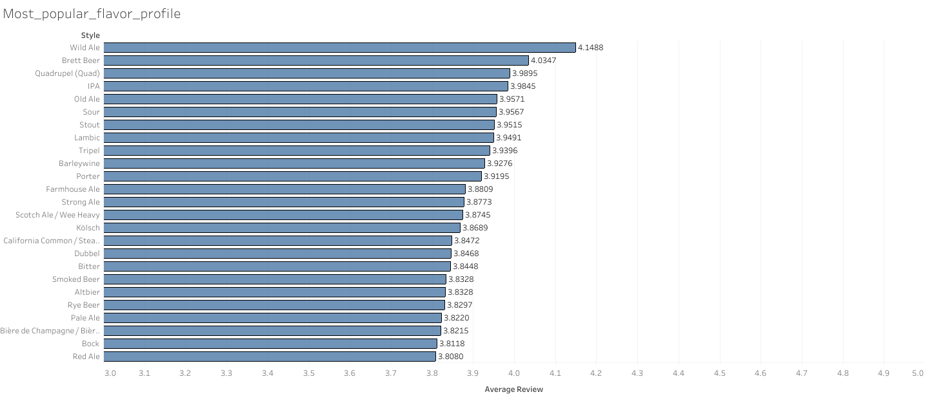
Most popular flavor profile based on reviews from dataset.
Most popular flavor profile based on review scores using a 3-5 point scale. Showing the top 25 in this category.

Slide 13
Beer Recommender Application

